Slide 1
OrganicCrop Forecast: Region-Wise Demand and Price Estimator
CSE7101- Capstone Project
Review-1
Batch Number: ISE_1
Under the Supervision of,
Dr. Murali Parameswaran
Professor
School of Computer Science and Engineering
Presidency University
Roll Number | Student Name
20221ISE0108 | Kavana R
20221ISE0109 | Pallavi J
20221ISE0104 | Bharathi Neeralakeri
Name of the Program: Information Science and Engineering
Name of the HoD: Dr. Zafar Ali Khan
Name of the Program Project Coordinator: Ms. Suma N G
Name of the School Project Coordinators: Dr. Sampath A K , Dr. Geetha A

Slide 2
Problem Statement Number: PSCS_150
Organization: Agriculture,FoodTech & Rural Development.
Category : Software
Problem Description: Developing solutions, keeping in mind the need to enhance the primary sector of India – Agriculture and to manage and process our agriculture procedure.

Slide 3
Content
Problem Statement
Objectives
Background and Related work for title Selection
Analysis of Problem Statement
Innovation or Novel Contributions
Git-hub Link
Timeline of the Project
References

Slide 4
Problem Statement
Farmers and agri-traders face challenges in predicting future demand and prices of organic crops. Existing systems mostly provide historical data or advisory services, but lack reliable market estimation and forecasting tools. This results in poor crop planning, financial losses, and uncertainty in the organic agriculture sector.

Slide 5
Objectives
Collect and preprocess region-wise datasets (price, arrivals, weather, seasonal cycles) for selected organic crops.
Develop AI/ML forecasting models (ARIMA, Prophet, LSTM) to estimate demand and prices.
Create an interactive dashboard (HTML/JS + Flask backend) to visualize trends.
Provide actionable insights (demand growth, price volatility, profit indicators).
Support farmers, policymakers, and stakeholders in decision-making.

Slide 6
Background and Related work for title Selection
Prior research has explored time-series forecasting for agricultural commodities using ARIMA, SARIMA, Prophet, and deep learning models (LSTM/GRU).
Datasets from Agmarknet, FAOSTAT, and State Agriculture Boards have been widely used in agri-economic studies.
Existing platforms (e.g., Agmarknet portal, FPO apps) mainly provide historical prices or advisories, but lack predictive analytics for organic produce.
Gap: Few systems focus on organic crops + region-wise market estimation, making this project novel and impactful.

Slide 7
Analysis of Problem Statement
Input: Historical mandi price data (min/max/modal), arrivals (supply), weather factors (rainfall, temperature), seasonal/festival indicators.
Processing: Data cleaning, feature engineering, forecasting models (Prophet, LSTM).
Output:Future price trends (6–12 months).
Demand-supply estimation.
Region-wise forecasts (Bengaluru, Mysuru, Hubli).
Impact:Farmers → better crop planning.
Policymakers → improved agri-market policies.
Traders/FPOs → optimized buying/selling strategies.

Slide 8
Analysis of Problem Statement
Technology Stack Components:
Programming Languages:
-Python 3.10+ → Data collection, preprocessing, ML/AI modeling
-HTML, CSS, JavaScript → Frontend dashboard
2. Libraries & Frameworks (Python):
-Data Handling & Preprocessing: Pandas, NumPy
-Visualization: Matplotlib, Seaborn
-ForecastingModels:ARIMA/SARIMA(statsmodels),Prophet(Meta), LSTM/GRU(TensorFlow/PyTorch)
-Machine Learning Tools: Scikit-learn
-APIs/Backend: Flask or FastAPI

Slide 9
Analysis of Problem Statement
3. Frontend (Visualization & UI):
-Chart.js → Interactive graphs and trend visualization
-Bootstrap/Tailwind CSS (optional) → Clean UI
4. Database (optional but recommended):
-MySQL / PostgreSQL → Storing historical and forecasted crop data
5. Tools & Platforms:
-VS Code / Jupyter Notebook → Development environment
-GitHub → Version control and project repo
-Google Colab / Kaggle → Model training & experiments
-Agmarknet / FAOSTAT / IMD → Dataset sources

Slide 10
Github Link
The Github link provided should have public access permission.
Github Link
https://github.com/kavan-r/OrganicCrop-Forecast

Slide 11
Analysis of Problem Statement (contd...)
Software Requirements:
Programming Language: Python 3.10+
Libraries: Pandas, NumPy, Scikit-learn, TensorFlow/PyTorch, Prophet,Statsmodels
Visualization: Matplotlib, Seaborn, Chart.js (for dashboard)
Backend Framework: Flask / FastAPI
Frontend: HTML, CSS, JavaScript
Database (optional): MySQL / PostgreSQL
Tools: VS Code, Jupyter Notebook, Google Colab, GitHub

Slide 12
Analysis of Problem Statement (contd...)
Hardware Requirements:
Laptop/Desktop with 8 GB RAM
Intel i5 or higher processor
50 GB free storage for datasets and models
Optional: Cloud platforms (Google Colab, AWS, Azure) for training heavy AI models

Slide 13
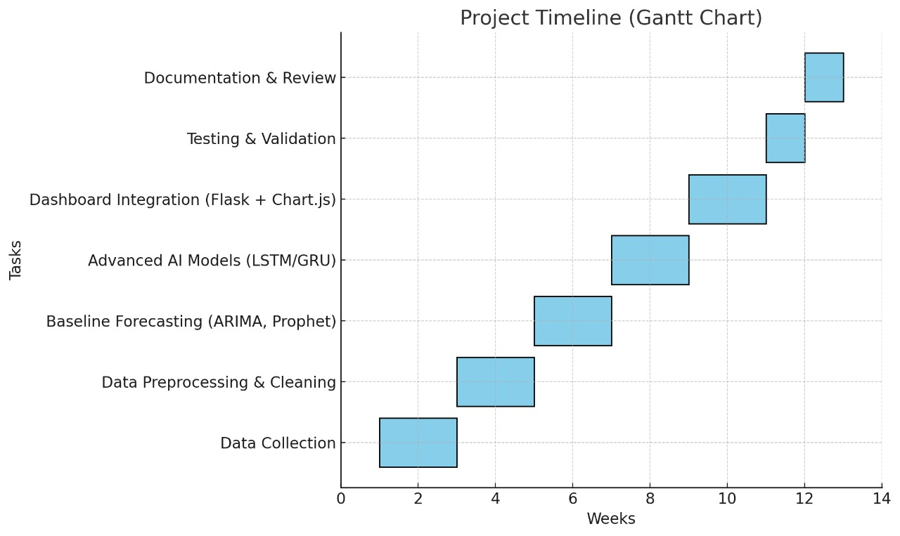
Timeline of the Project (Gantt Chart)
Week 1–2: Data collection (Agmarknet, FAOSTAT, IMD).
Week 3–4: Data preprocessing & cleaning.
Week 5–6: Baseline forecasting (ARIMA, Prophet).
Week 7–8: Advanced AI models (LSTM/GRU).
Week 9–10: Dashboard integration (Flask + Chart.js).
Week 11: Testing & validation.
Week 12: Documentation & Review.

Slide 14
References (IEEE Paper format)
  [1]. A. Kumar, B. Patel, and C. Zhang, “Agricultural price forecasting using ARIMA and LSTM,” IEEE Access, vol. 9, pp. 34567–34578, Mar. 2021.
  [2]. J. Smith, “Deep learning in agricultural systems,” IEEE Trans. Neural Netw. Learn. Syst., vol. 32, no. 7, pp. 1234–1245, Jul. 2021.
  [3]. Ministry of Agriculture, “Agmarknet Portal,” Govt. of India. [Online]. Available: https://agmarknet.gov.in
  [4]. FAOSTAT, “Food and Agriculture Data,” Food and Agriculture Organization. [Online]. Available: http://www.fao.org/faostat/
  [5]. S. Patel et al., “Machine learning applications in agricultural commodity forecasting,” Elsevier Agricultural Systems, vol. 195, pp. 102–115, 2021.

Slide 15


